Slide 1

iOS App Development with Xamarin and F#
Twitter: @rachelreese
Blog: Rachelree.se
Github: rachelreese
Notes:
Work at FFL using iOS and F#.
Just helped start the Nash F# user group.
Previously ran VT Fun.
This was a difficult talk to put together. Half the room knows F#, but not iOS or Xamarin, and the other half’s the opposite.
Start w/ covering why you should consider F#
Then some language basics
And Xamarin basics.

Slide 2

Why F#?

Slide 3
F#…offers us an order of magnitude increase in productivity and allows one developer to perform the work…of a team of dedicated developers on an existing Java-based solution...
Yan Cui
Lead server Engineer, Gamesys (source)

Slide 4
I have now delivered three business critical projects written in F#. I am still waiting for the first bug to come in. This is not the case with the C# projects I have delivered.
Simon Cousins
UK-based Power Company (Source)
Notes:
Clarity & conciseness of code.

Slide 5
The UI work is especially gratifying, because state of the art for a lot of genomic data display is still PNG images embedded in JavaScript and with F# I can render half a million data points on a web page without jumping through hoops.
Darren Platt
Amyris Biotechnology (source)
Notes:
F# gets flack for lack of UI support.

Slide 6
F# Fundamentals
operaHouses //(Name, Current Productions) for each opera house
|> Array.map (fun (x,y) -> x, y |> Seq.toArray)) |> Array.filter (fun (x,y) -> y.Length > 0)
|>, Whitespace
StartNewGame <| GetNewGameBoard()
[1..10] |> List.filter (fun x -> x % 2 = 0) |> List.map (fun x -> x + 3) |> List.sum
//names is tuple of (name, id)
Array.Parallel.partition (fun g -> ids.Contains(snd g)) names |> fst
|> Array.toList

Slide 7
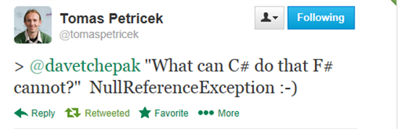
F# Fundamentals
Option Types
Quote of the Week blog post
Notes:
NullReferenceException can be obviated because of option types.

Slide 8
F# Fundamentals
Can be used on any type (strings, functions)
When pattern matched on, forces you to consider None case
Can use map, iter, etc. functions.
Nestable: Option<Option<int>> is valid.
Option Types
Notes:
Similar to Nullable<int> etc, but different because:

Slide 9
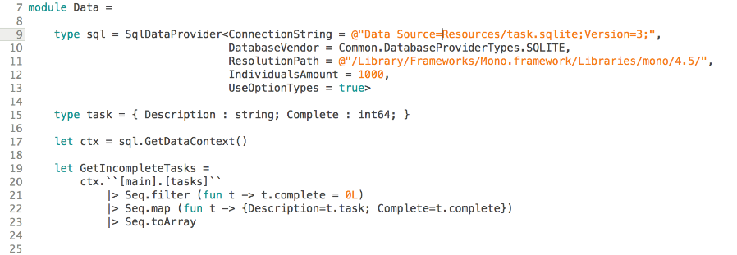
Why F#? Type Providers

Slide 10
Some existing type providers.
powershell
Azure
Choose your own adventure
Matlab
RSS
DBML
SignalR
FunScript
R
Python
MS Dynamics CRM
World Bank
CSV
XML
IKVM
SQL Server
SQL Server with EF
XAML
Hadoop
WSDL
OData
Apiary
Facebook
MVVMCross
Squirrels
File System
Dates
Oracle
EDM
Minesweeper
Freebase
SQLite
JSON
Regex
LINQ
See here for a full list.

Slide 11
Get creative.
Get data from
Hadoop
SQL Server
RSS
Freebase
CSV
OData
World Bank
JSON
Process with
Matlab
Powershell
Regex
R
SignalR
Python
LINQ
Visualize with
F#
Matlab
R
SQLite
Oracle

Slide 12
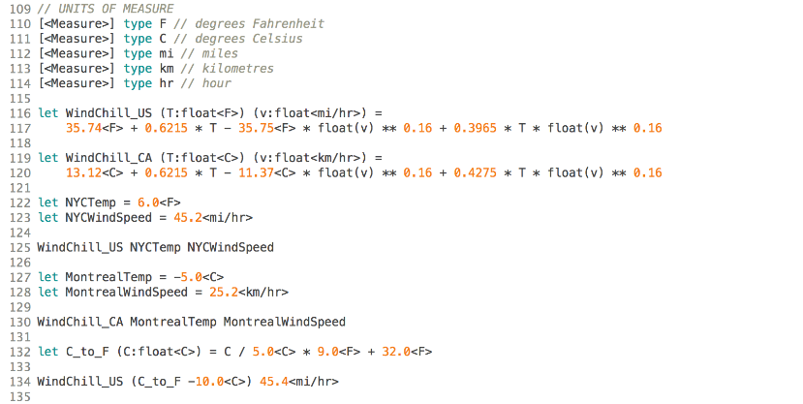
Why F#: Units of Measure

Slide 13
Why F#: Concise Code
F#
C#
type Transport =
| Car of Make:string * Model:string
| Bus of Route:int
| Bicycle
public abstract class Transport{ }
public abstract class Car : Transport {
public string Make { get; private set; }
public string Model { get; private set; }
public Car (string make, string model) {
this.Make = make;
this.Model = model;
}
}
public abstract class Bus : Transport {
public int Route { get; private set; }
public Bus (int route) {
this.Route = route;
}
}
public class Bicycle: Transport { }
...

Slide 14
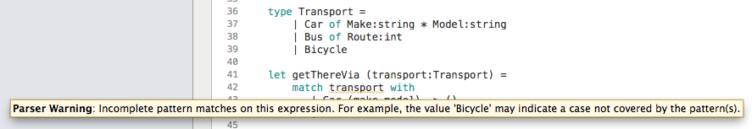
Why F#: Pattern Matching
type Transport = | Car of Make:string * Model:string | Bus of Route:int | Bicycle let getThereVia (transport:Transport) = match transport with | Car (make,model) -> () | Bus route -> ()

Slide 15
Why Xamarin?
Fully Native
Cross Platform
Notes:
Managing the SDKs locally can lead to hours and hours of time lost.
PhoneGap (JS, HTML5, CSS)
Not native. Slower.
Appcelerator: Javascript API plus native UI components.
Required to manage SDKs locally.

Slide 16
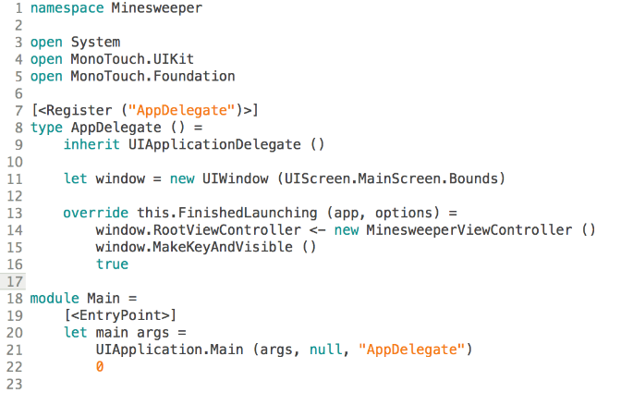
iOS Fundamentals: AppDelegate
Notes:
AppDelegate must be registered
Main needs to be labeled as an Entry Point.
FinishedLaunching:
Set root view controller.

Slide 17
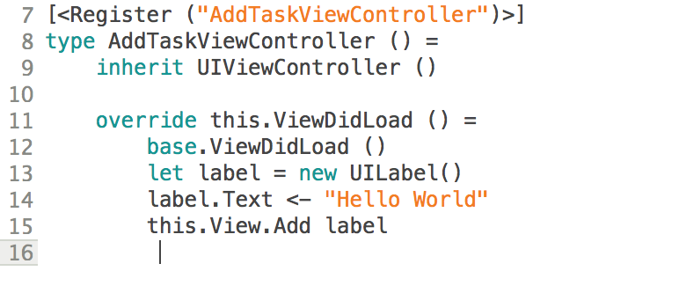
iOS Fundamentals: ViewController
Notes:
Register each view controller.
Override ViewDidLoad, ViewWillAppear, ViewDidAppear…

Slide 18

Minesweeper & Tasky

Slide 19
iOS App Development with Xamarin and F#
Twitter: @rachelreese
Blog: Rachelree.se
Github: rachelreese

